Slide 1
Thermodynamic cycle
Student Names

Slide 2
Introduction
Generalities

Slide 3
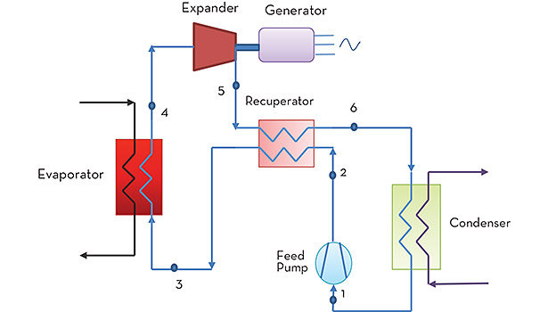
Cycle description
https://www.achrnews.com/articles/126941-uk-considers-organic-rankine-cycle

Slide 4
Ideal and actual cycles (property diagrams)

Slide 5
Energy and mass balances within the components of the cycle.

Slide 6
Options for Improving Cycle Efficiency

Slide 7
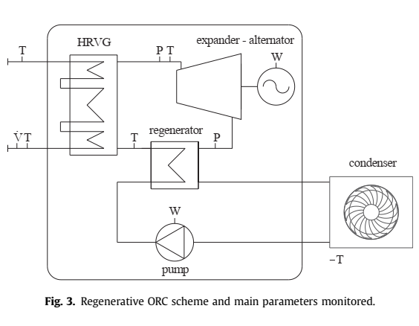
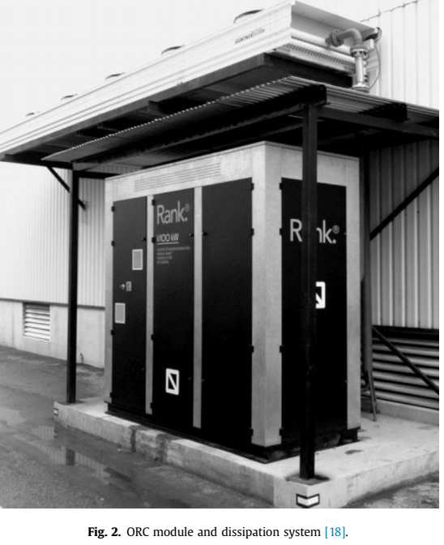
Please provide at least three examples of cycle applications.

Slide 8
Conclusions

Slide 9
References

